Slide 1
BIBIKE
BIBIKE LTD
AN INTELLIGENT INVENTORY MANAGEMENT SYSTEM

Slide 2
PROBLEM STATEMENT
The problem we address is the inefficiency of current inventory management practices across diverse sectors such as retail, warehousing, manufacturing, and internal company operations. Many businesses struggle with manual and outdated systems that lack scalability, customization, and optimization capabilities. This results in frequent stockouts, excess inventory, and poor visibility throughout the supply chain. These issues lead to lost sales opportunities, increased carrying costs including storage expenses and depreciation, and operational inefficiencies such as delays, errors, and higher labor costs associated with manual inventory management processes.

Slide 3
HOW DO WE
SOLVE THE PROBLEM
The solution offered by our startup is a comprehensive, scalable, and AI-powered inventory management system. It aims to streamline processes, optimize inventory levels, reduce stockouts, minimize excess inventory, and enhance supply chain visibility across various sectors including retail, warehousing, manufacturing, and internal operations. This solution enables businesses to improve productivity, cut costs, and make informed decisions to drive growth and profitability by addressing inefficiencies in inventory management practices.

Slide 4
01
TARGET CUSTOMER
RETAILERS
Small, medium, and large retailers who need to manage their inventory of products effectively to meet customer demand, reduce stockouts, and optimize sales.
02
WAREHOUSES
Distribution centers, logistics companies, and warehouses that require efficient inventory management solutions to track and manage incoming and outgoing stock, optimize storage space, and streamline operations.
03
MANUFACTURERS
Companies involved in manufacturing processes, including raw material procurement, production, and distribution of finished goods. Our solution caters to manufacturers seeking to optimize their supply chain, track inventory levels, and improve production efficiency.
04
INTERNAL COMPANY INVENTORY
Businesses with internal inventory needs, such as IT equipment, office supplies, and maintenance materials. Our solution provides transparency and accountability for internal inventory usage, facilitating efficient resource allocation and cost management.

Slide 5
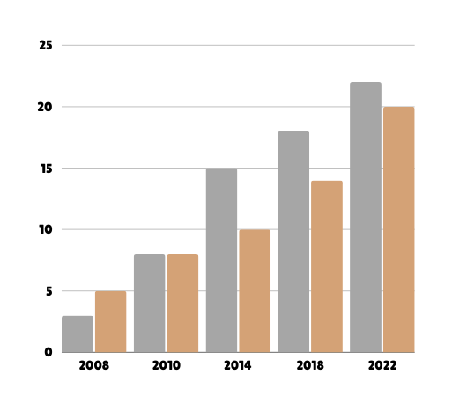
The global inventory management software market is experiencing significant growth due to the increasing demand for automation and efficiency in supply chain operations. According to recent market research reports:
MARKET SIZE
The global inventory management software market was valued at approximately USD 3.2 billion in 2020.
It is projected to reach around USD 5.9 billion by 2027, growing at a compound annual growth rate (CAGR) of about 8.5% during the forecast period.

Slide 6
PRODUCT TRACTION
Development Stage: Minimum Viable Product (MVP) undergoing rigorous testing with a diverse group of businesses. This initial phase is crucial for gathering user feedback and ensuring our solution aligns perfectly with market needs. Early market validation indicators include:
a) industry reports projecting significant market growth in inventory management software,
b) user interviews highlighting a strong demand for the functionalities we offer, and
c) high user engagement with our MVP testing program.

Slide 7
BUSINESS MODEL
MONETIZATION STRATEGY: SUBSCRIPTION-BASED MODEL
We will leverage a subscription model with tiered pricing to fit various business sizes. This provides recurring revenue, allows for scalability, and increases customer lifetime value. Basic, Standard, and Enterprise tiers will offer features tailored to specific needs. We may also explore additional revenue streams like data insights and implementation services, but our core focus will be on delivering exceptional value through our platform to ensure customer satisfaction and sustainable growth.

Slide 8
COMPETITORS AND COMPETITIVE ADVANTAGE
We compete with established (SAP, Oracle, Microsoft Dynamics) and new players (Fishbowl, TradeGecko). Our AI-powered solution with unmatched usability and collaboration features sets us apart.
AI optimizes inventory, minimizes stockouts, and scales to your needs.
User-friendly interface empowers all users, unlike complex competitor offerings.
Streamlined collaboration fosters seamless team communication and workflow.
We empower businesses to optimize inventory management and unlock collaboration through a user-centric approach.

Slide 9
FUNDING STATUS
We are currently in the self-funded development stage. Our Minimum Viable Product (MVP) is undergoing testing with a select group of businesses, and we are actively seeking seed funding to fuel our next phase of growth.

Slide 10
THANKS FOR
WATCHING
BIBIKE LTD

